Slide 1
14
Molecular Evolution and Population Genetics

Slide 2
Population Genetics
Gene pool = the complete set of genetic information in all individuals within a population
Genotype frequency = proportion of individuals in a population with a specific genotype
Genotype frequencies may differ from one population to another
Allele frequency = proportion of any specific allele in a population
Allele frequencies are estimated from genotype frequencies

Slide 3
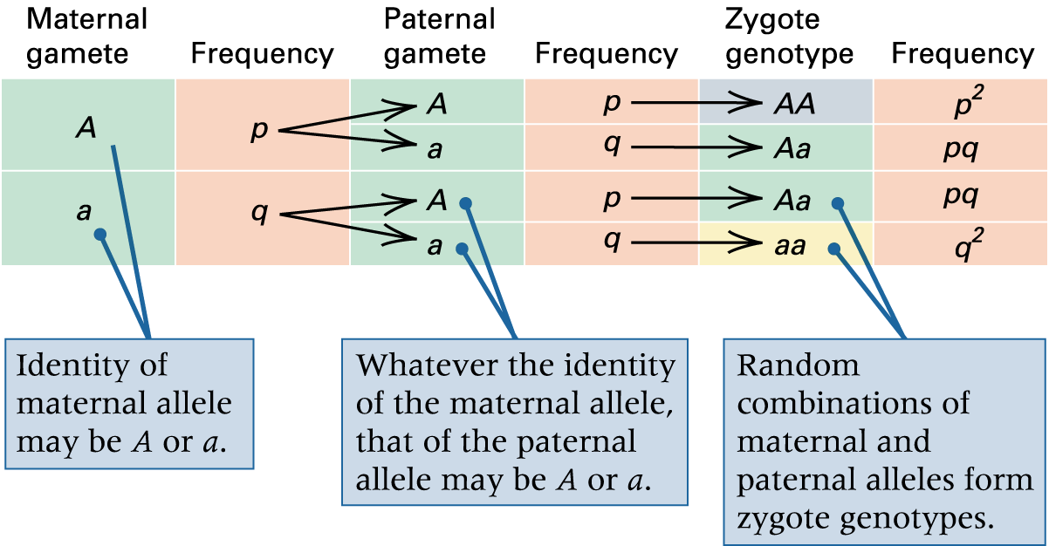
Allele frequencies when mating is random

Slide 4
Hardy–Weinberg Principle
When gametes containing either of two alleles, A or a, unite at random to form the next generation, the genotype frequencies among the zygotes are given by the ratio
p² : 2pq : q²
this constitutes the Hardy–Weinberg (HW) Principle
p = frequency of a dominant allele A
q = frequency of a recessive allele a
p + q =1

Slide 5
Hardy–Weinberg Principle
One important implication of the HW Principle is that allelic frequencies will remain constant over time if the following conditions are met:
The population is sufficiently large
Mating is random
Allelic frequencies are the same in males and females
Selection does not occur = all genotypes have equal in viability and fertility
Mutation and migration are absent

Slide 6
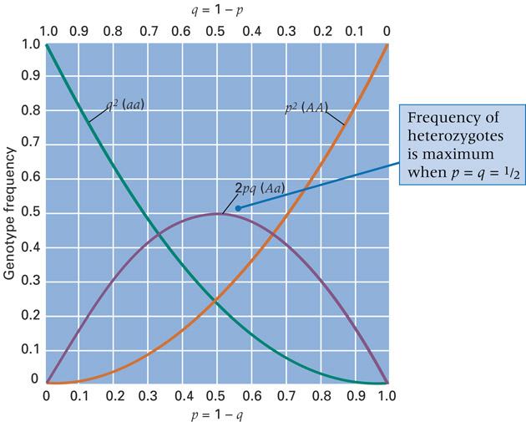
Hardy–Weinberg Principle
Another important implication is that for a rare allele, there are many more heterozygotes than there are homozygotes for the rare allele
Fig. 14.12

Slide 7
Hardy–Weinberg Principle
HW frequencies can be extended to multiple alleles:
Frequency of any homozygous genotype = square of allele frequency = p_{i}²
Frequency of any heterozygous genotype = 2 x product of allele frequencies = 2p_{i}p_{j}

Slide 8
Evolution
Changing Allele Frequencies
  1. Mutation = the origin of new genetic capabilities in populations = the ultimate source of genetic variation
  2. Natural selection = the process of evolutionary adaptation = genotypes best suited to survive and reproduce in a particular environment give rise to a disproportionate share of the offspring
  3. Migration = the movement of organisms among subpopulations
  4. Random genetic drift = the random, undirected changes in allele frequencies, especially in small populations

Slide 9
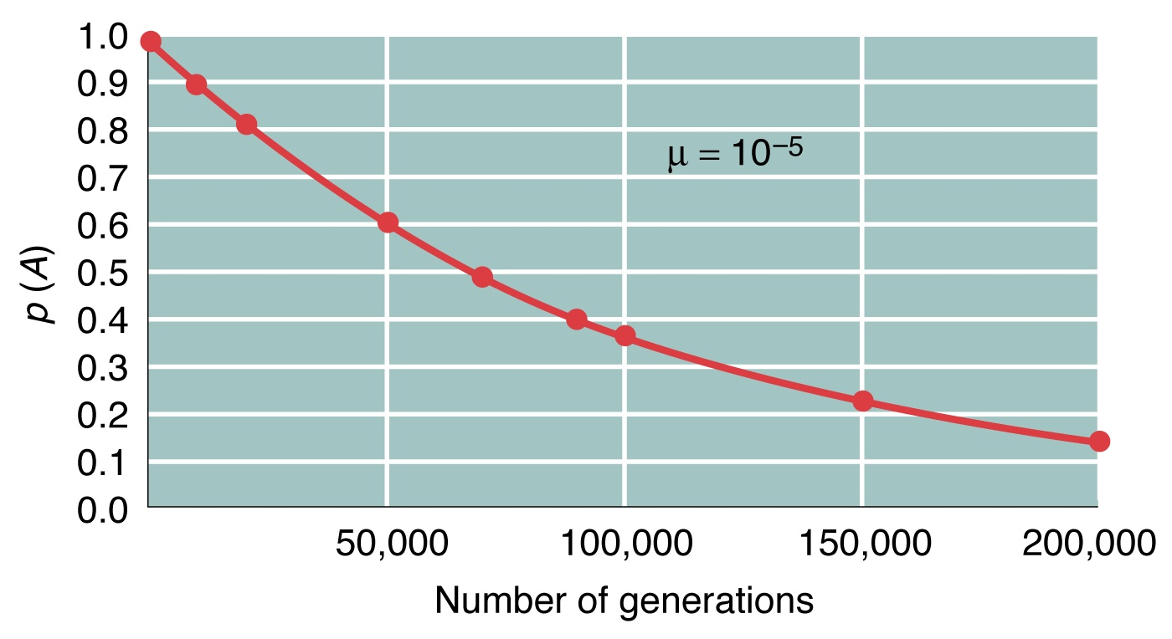
mutations
1 generation
p = -µp
n generations
p_{n} = p₍₀₎e^{-µn}

Slide 10
Selection and Fitness
Organisms differ in their ability to survive and reproduce, and some of these differences are due to genotype
Fitness (W) is the relative ability of genotypes to survive and reproduce
Relative fitness measures the comparative contribution of each parental genotype to the pool of offspring genotypes in each generation
Selection coefficient refers to selective disadvantage of a disfavored genotype

Slide 11
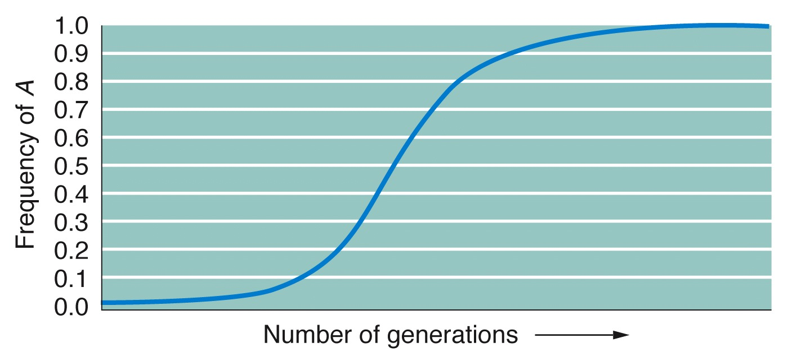

Slide 12
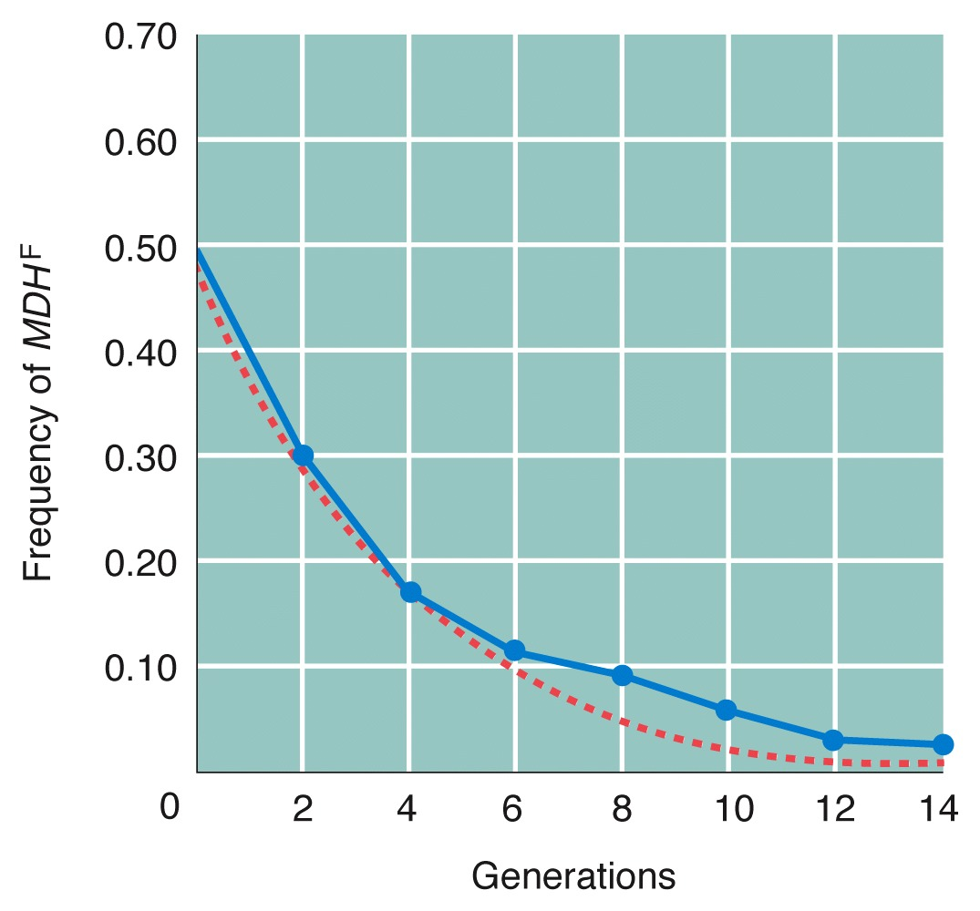
Selection can affect frequencies quite rapidly
W_{AA}= 1.00
W_{Aa}= 0.75
W_{aa}= 0.40

Slide 13
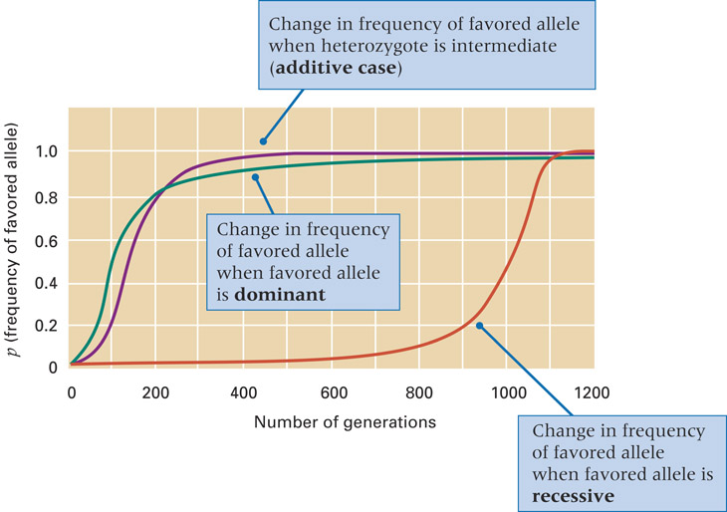
Selection in Diploids
Frequency of favored dominant allele changes slowly if allele is common
Frequency of favored recessive allele changes slowly if the allele is rare
Rare alleles are found most frequently in heterozygotes
When favored allele
is dominant, recessive
allele in heterozygotes is
not exposed to natural
selection

Slide 14
Heterozygote Superiority
Heterozygote superiority = fitness (measurement of viability and fertility) of heterozygote is greater than that of both homozygotes
When there is heterozygote superiority, neither allele can be eliminated by selection
In sickle cell anemia, allele for mutant hemoglobin is maintained in high frequencies in regions of endemic malaria because heterozygotes are more resistant to to this disease

Slide 15
Selection in Diploids
Selection can be balanced by new mutations
New mutations often generate harmful alleles and prevent their elimination from the population by natural selection
Eventually the population will attain a state of equilibrium in which the new mutations exactly balance the selective elimination

Slide 16
Migration
Population on island (i) has migrants (m) from the mainland
Allele frequency in the next generation is the weighted avergare of the two populations
p’_{(i)} = (1-m)p_{(i)} + (m)p_{(m)}

Slide 17
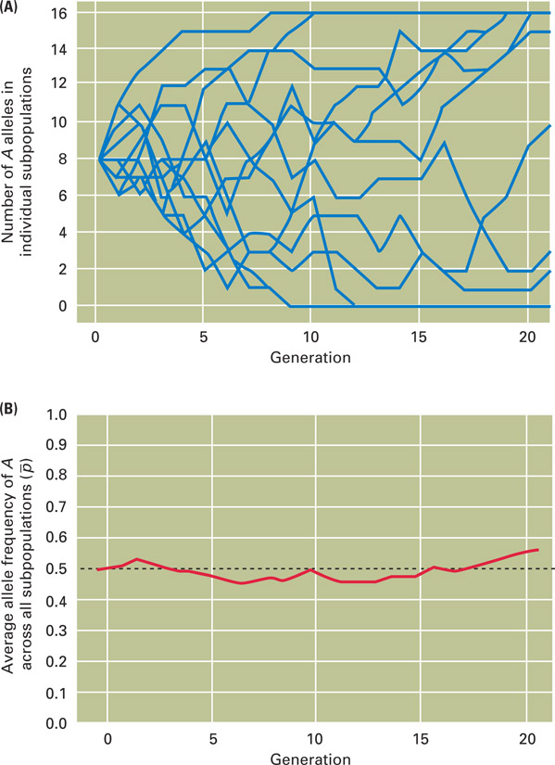
Random Genetic Drift
Some changes in allele frequency are random due to genetic drift
Random genetic drift comes about because populations are not infinitely large
Only relatively few of the gametes participate in fertilization = sampling
With random genetic drift, the probability of fixation of an allele is equal to its frequency in the original population
Fig. 14.27

Slide 18
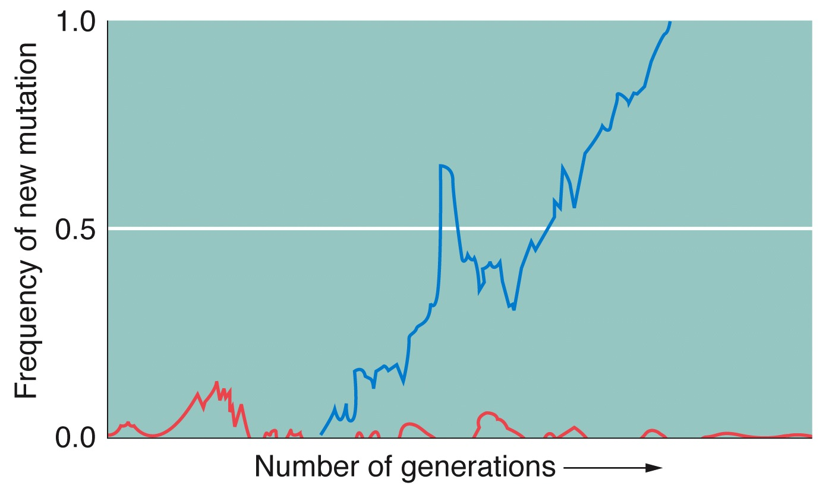
Random Genetic Drift
Chance that a new mutation will be lost:
(2N-1)/(2N)
Chance that a new mutation will become fixed in the population:
1/(2N)

Slide 19
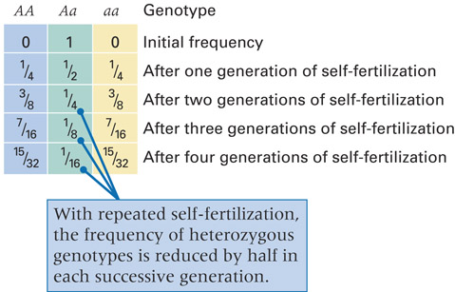
Inbreeding
Inbreeding means mating between relatives
Inbreeding results in an excess of homozygotes compared with random mating
In most species, inbreeding is harmful due to rare recessive alleles that wouldn’t otherwise
become homozygous

Slide 20
Inbreeding
A convenient measure of effects of inbreeding is based on the reduction of heterozygosity H_{I} and is called the inbreeding coefficient F
F = (2pq - H_{I} )/2pq
The overall genotype frequencies in the inbreed population are
f(AA)= p²(1 - F) + pF
f(Aa)= 2pq(1 - F)
f(aa)= q²(1 - F) + qF

Slide 21
Molecular evolution
The discovery that DNA is the genetic material made it possible to compare corresponding genes even in distantly related species
DNA and protein sequences contain information about evolutionary relationships among species
Comparative studies of macromolecules, the study of how and why their sequences change through time constitutes molecular evolution

Slide 22
Molecular evolution
Accumulation of sequence differences through time is the basis of molecular systematics, which analyses them in order to infer evolutionary relationships
A gene tree is a diagram of the inferred ancestral history of a group of sequences
A gene tree is only an estimate of the true pattern of evolutionary relations
Neighbor joining = one of the way to estimate a gene tree
Bootstrapping = a common technique for assessing the reliability of a node in a gene tree
Taxon = the source of each sequence

Slide 23
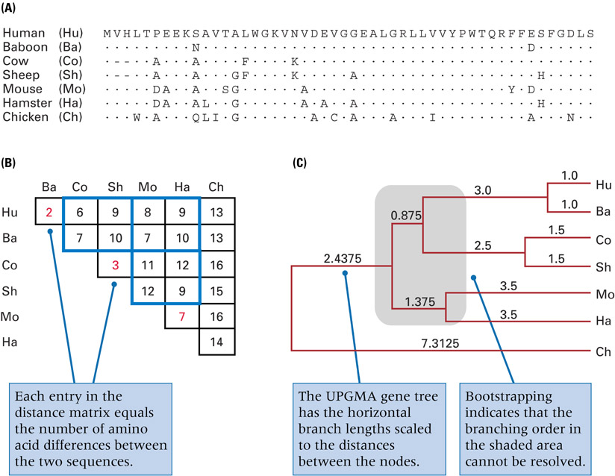
Fig. 14.1

Slide 24
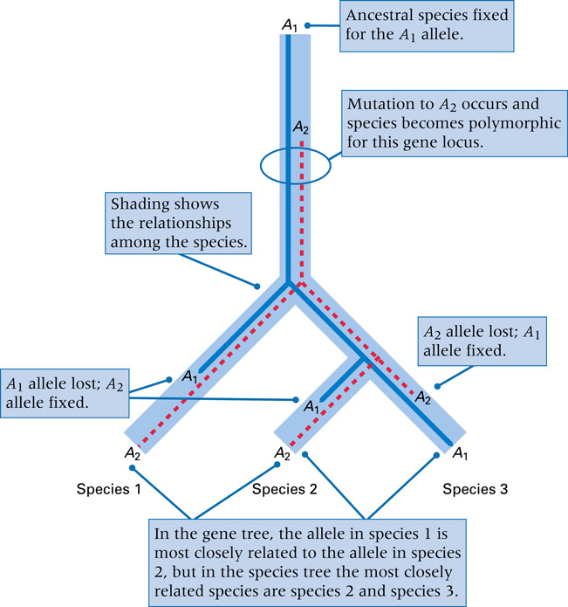
Molecular evolution
A gene tree does not necessarily coincide with a species tree:
  The sorting of polymorphic alleles in the different lineages
  Recombination within gene make it possible for different parts of the same gene to have different evolutionary histories

Slide 25
Molecular evolution
Rate of sequence evolution = the fraction of sites that undergo a change in some designated time interval = number of replacements per site per billion years
Rates of evolution can differ dramatically from one protein to another

Slide 26
Molecular evolution
There are different kind of nucleotide sites and nucleotide substitutions depending on their position and function in the genome
Synonymous substitution = no change in amino acid sequence = primarily at the third codon position
Nonsynonymous substitution = amino acid replacement
Rates of evolution of nucleotide sites differ according to their function

Slide 27
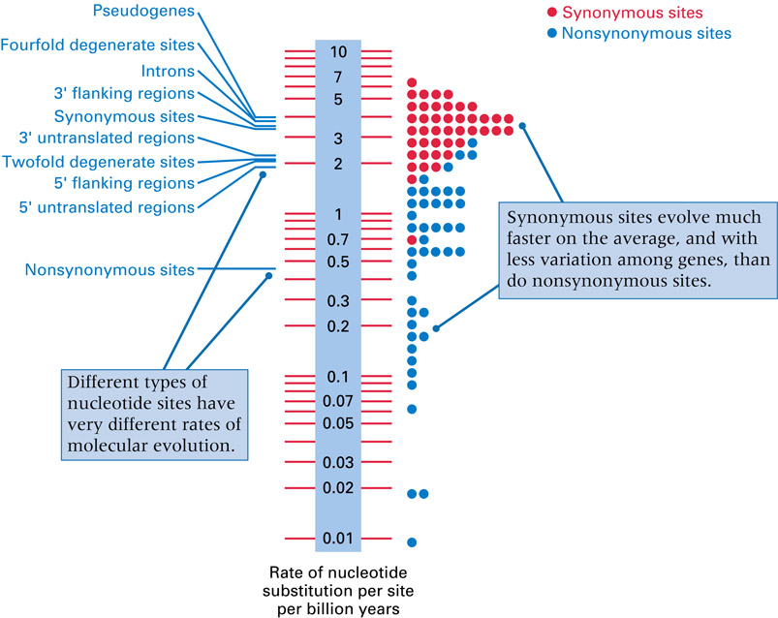
Fig. 14.3

Slide 28
Molecular evolution
New genes usually evolve through duplication and divergence
Ortologous genes = duplicated as an accompaniment to speciation, retain the same function
Paralogous genes = duplicated in the genome of the same species, acquire new or more specialized function
Pseudogenes = duplicated genes that have lost their function

Slide 29
Population Genetics
Population genetics = application of genetic principles to entire populations of organisms
Population = group of organisms of the same species living in the same geographical area
Subpopulation = any of the breeding groups within a population among which migration is restricted
Local population = subpopulation within which most individuals find their mates

